Slide 1


COMPARING IMPUTATION AND CLUSTERING PIPELINES ON INCOMPLETE NEWSPAPER-REPORTED SUICIDE DATA FROM BANGLADESH
A 32-pipeline factorial benchmark with a balance-aware composite score
Bangladesh University of Business and Technology
Department of Computer Science and Engineering
Capstone Defense, June 2026

Slide 2




THE TEAM
Mohammed Akash
ID: 21221203019
Intake: 40
Sajedul Islam
ID: 21221203022
Intake: 40
Md Arifuzzan
ID: 21221203034
Intake: 40
Komol Chandra Devnath
ID: 21221203028
Intake: 40
Anisul Haque Bhuiyan
ID: 20211203010
Intake: 37
Supervised by:
Md. Mamun Hossain
Assistant Professor
Dept of Computer Science and Engineering
Bangladesh University of Business and Technology
02

Slide 3
OVERVIEW
01
Background and the
data problem
04
Methodology -
the 32-pipeline benchmark
02
Literature review and
the research gap
05
Results, cluster profiles,
feature comparisons
03
Research question
and objectives
06
Honest findings, limitations,
what's next
03

Slide 4
SECTION 02
BACKGROUND
04

Slide 5

SUICIDE IN BANGLADESH
A public-health crisis without a national surveillance system.
05

Slide 6
73,597
DEATHS
/ between 2020 and 2024
Source: Bangladesh Police records, 2020 – 2024
14,719
DEATHS
/ on average per year
Source: Bangladesh Police nationwide data, 2025
40
DEATHS
/ per day
Source: Bangladesh Police (AIG Ashraful Islam), reported by Prothom Alo, 2025
06

Slide 7
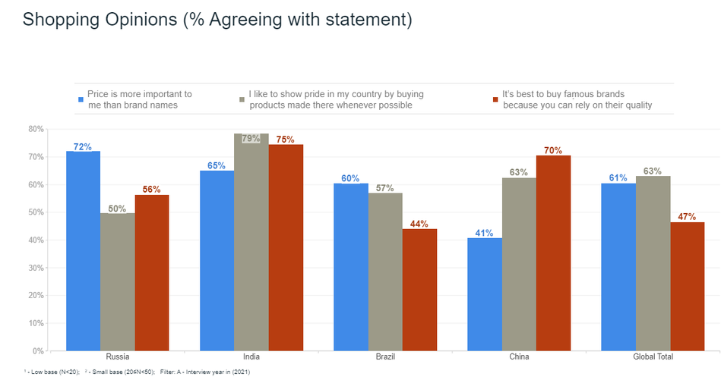
The true figure is higher
  STIGMA
  CULTURAL BARRIERS
  NO SURVEILLANCE SYSTEM
WHO; Arafat et al., 2025 (Health Science Reports)
07

Slide 8
SECTION 03
THE DATA PROBLEM
08

Slide 9

NEWSPAPERS ARE
THE ONLY SOURCE
09

Slide 10
50-90%
of critical fields are missing across the dataset
0%
25%
50%
75%
100%
  Age, occupation, marital status
  Mental-health history
  Socio-economic indicators
  Latitude and longitude
  Weather and environmental context
10

Slide 11
STANDARD MACHINE LEARNING CANNOT RUN ON DATA THIS BROKEN.
  Complete-case analysis discards most of the dataset.
  Naive mean substitution introduces distributional bias.
11

Slide 12
SECTION 04
LITERATURE REVIEW
12

Slide 13
BANGLADESHI NEWSPAPER SUICIDE RESEARCH
Arafat et al. (2018)
Title: Demography and risk factors of suicidal behavior in Bangladesh — retrospective online news content analysis
Journal: Asian Journal of Psychiatry
Finding: Manual grouping only · no algorithmic clustering applied
Arafat et al. (2025)
Title: Prevalence of suicidal behavior in Bangladesh — systematic review and meta-analysis
Journal: Health Science Reports
Finding: Aggregate epidemiology · no case-level subgroup analysis
13

Slide 14
GLOBAL ALGORITHMIC CLUSTERING ON SUICIDE DATA
Xiao et al. (2025)
Title: Machine learning to investigate policy-relevant social determinants of health and suicide rates in the United States
Journal: BMC Public Health
Context: United States, community-level suicide rates
Method: ML on social determinants of health
Wong et al. (2022)
Title: From the hidden to the obvious — classification of primary and secondary school student suicides using cluster analysis
Journal: BMC Public Health
Context: Hong Kong primary and secondary school student suicides
Method: cluster analysis (K-Means)
14

Slide 15
THE RESEARCH GAP
1. No algorithmic clustering on Bangladeshi newspaper suicide data
2. No multi-method imputation benchmark in this domain
3. Prior studies use a single clustering algorithm — we use four
4. Standard validity indices fail on imbalanced social data
5. No prior work compares predictor-selection strategies during imputation
15

Slide 16
SECTION 05
RESEARCH FRAMING
16

Slide 17
RESEARCH QUESTION
Which combination of missing-data handling and unsupervised learning produces the most stable, interpretable cluster structure from Bangladeshi newspaper suicide records?
17

Slide 18
OBJECTIVES
  Expand and curate a Bangladeshi newspaper-reported suicide dataset spanning 2017–2025.
  Benchmark 3 imputation methods × 2 predictor strategies × 4 clustering algorithms.
  Design a balance-aware composite metric that demotes degenerate cluster solutions.
  Identify and interpret the top-ranked pipeline — and surface its caveats openly.
18

Slide 19
SECTION 06
METHODOLOGY
19

Slide 20
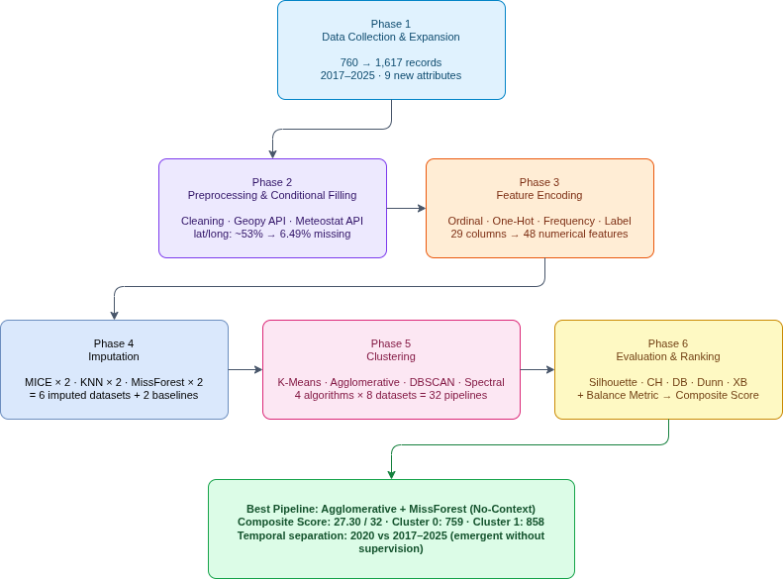
END-TO-END
PIPELINE
From newspaper scraping through cleaning, enrichment, imputation, clustering, and composite evaluation.
20

Slide 21
760 records | Public 2020 Kaggle dataset
857 records | Manually collected, 2017–2025
9 new attributes | Socio-economic and clinical fields added
36 columns | Raw
34 columns | After ethical removals (full_name, data_source)
29 columns | Final analytical feature set (13 categorical + 16 numerical)
DATASET
Total 1,617 records. From the time period of 2017 to 2025
21

Slide 22
  family_members
  position_in_siblings
  marital_status (new variant)
  duration_of_separation
  profession_description
  workplace (new variant)
  financial_condition
  previous_health_condition
  previous_suicide_attempt
NEW
ATTRIBUTES
ADDED
22

Slide 23
EXTERNAL API ENRICHMENT
Geopy: geocoding service · reduced lat/lon missingness from ~53% to 6.49%
Meteostat: Historical weather API · added feels_like, temp_min/max, humidity, wind, clouds, weather descriptions.
23

Slide 24
Ordinal categoricals | Frequency encoding
Low-cardinality nominals (gender, workplace, religion) | One-hot
High-cardinality nominals (hometown, profession_group) | Frequency / label encoding
MissForest input | Label encoding (tree-native)
ENCODING STRATEGY
We used different types of encoding based on the type of the feature.
24

Slide 25
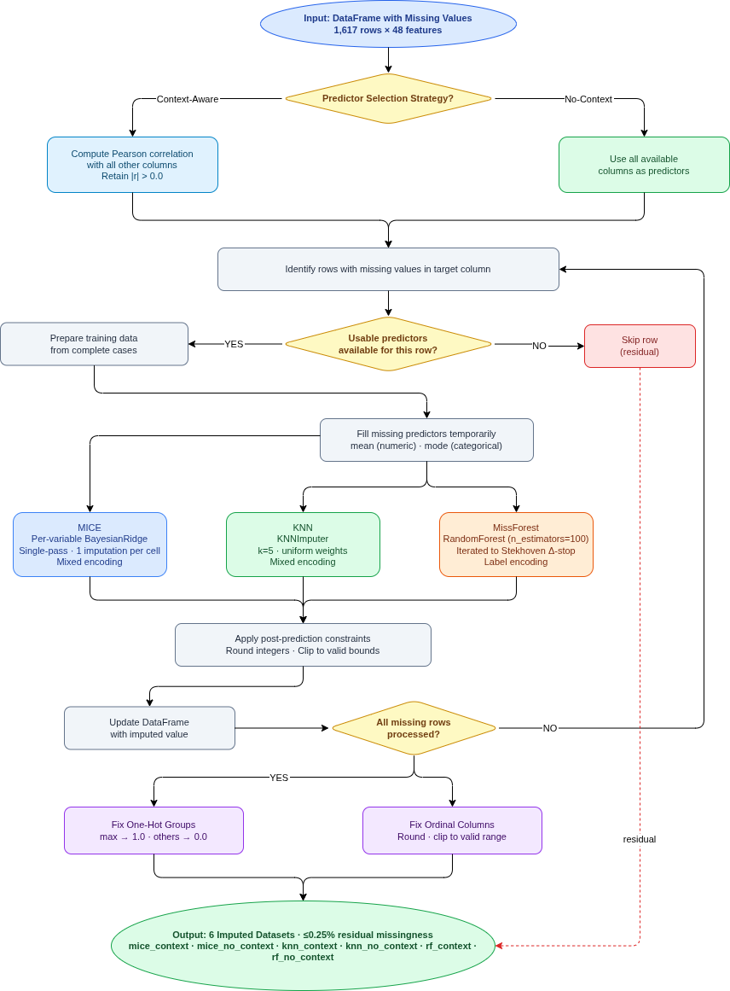
IMPUTATION WORKFLOW
Three methods · two predictor strategies · six imputed datasets · post-imputation residual missingness ≤ 0.25%.
25

Slide 26
3 IMPUTATION METHODS
MICE: per-variable BayesianRidge regression · single-pass MICE-style imputation
KNN: k = 5 nearest-neighbour averaging
MissForest: random forest per variable, 100 trees, iterated to Stekhoven convergence
26

Slide 27
2 PREDICTOR STRATEGIES
Context-aware: for each target column, predictors are the columns with non-zero Pearson/Cramér's V correlation to the target
No-context: all available columns serve as predictors
27

Slide 28
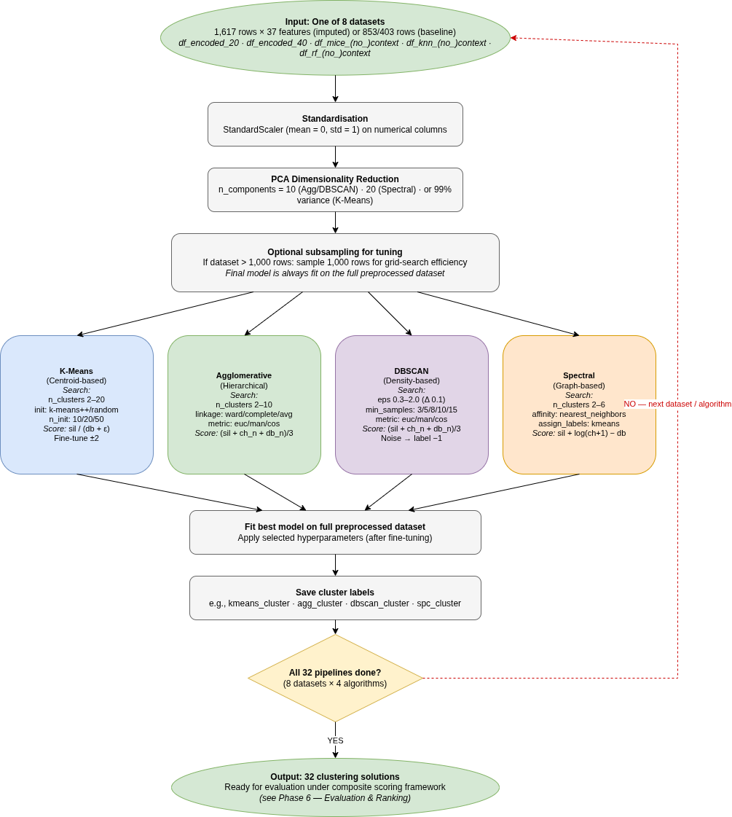
CLUSTERING WORKFLOW
Standardisation · PCA · per-algorithm grid search · composite ranking across all 32 pipelines.
28

Slide 29
Algorithm | Paradigm
K-Means | Centroid
Agglomerative | Hierarchical
DBSCAN | Density
Spectral | Graph
4 CLUSTERING ALGORITHMS
19

Slide 30
HYPERPARAMETER SEARCH RANGES
  K-Means: k ∈ [2, 20] · init ∈ {k-means++, random} · n_init ∈ {10, 20, 50} · max_iter ∈ {300, 500}
  Agglomerative: k ∈ [2, 10] · linkage ∈ {ward, complete, average, single}
  DBSCAN: eps ∈ grid · min_samples ∈ grid
  Spectral: k ∈ [2, 10] · affinity = nearest_neighbors · labels = kmeans
  PCA: 99% variance (K-Means) · 10 components (Agg, DBSCAN) · 20 components (Spectral)
30

Slide 31

STANDARD SCORES REWARD DEGENERATE SOLUTIONS.
Example: DBSCAN can label 99% of cases as noise and still score "high" on Silhouette.
Balance Metrics
The balance penalty stops lopsided or noise-heavy partitions from gaming the composite, so a high score reliably reflects a genuinely useful cluster solution rather than a degenerate one.
31

Slide 32
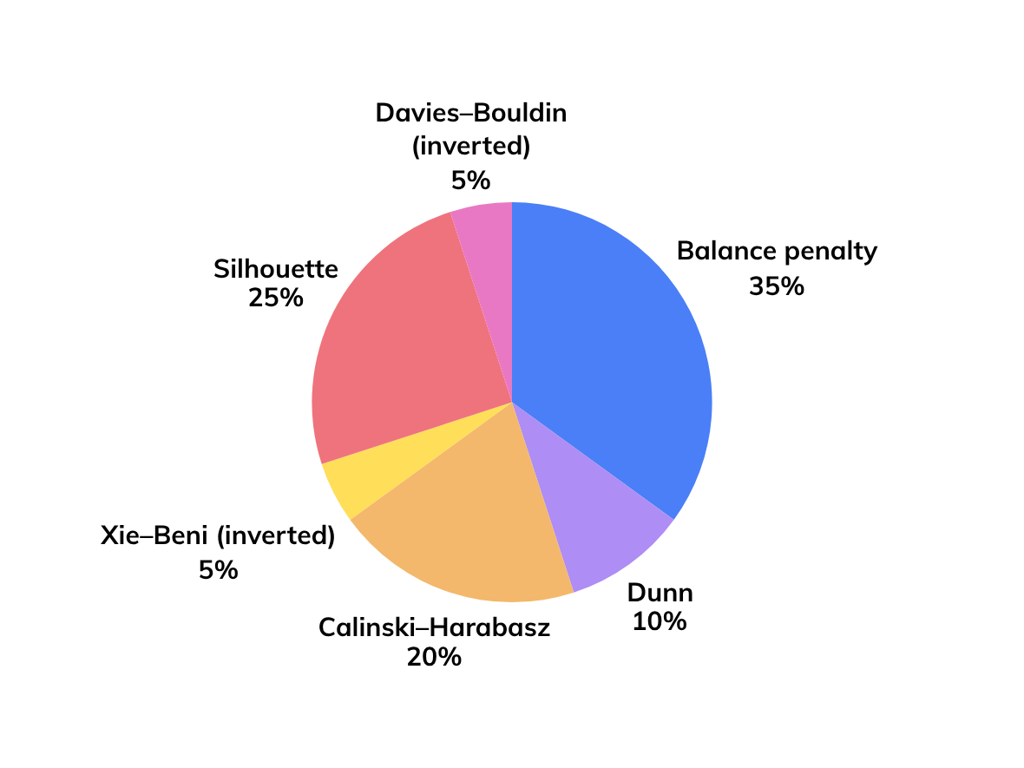
OUR SIX-COMPONENT COMPOSITE SCORE
The pie chart is showing the weight of the metrics in the composite score.
Maximum possible score: 32
32

Slide 33
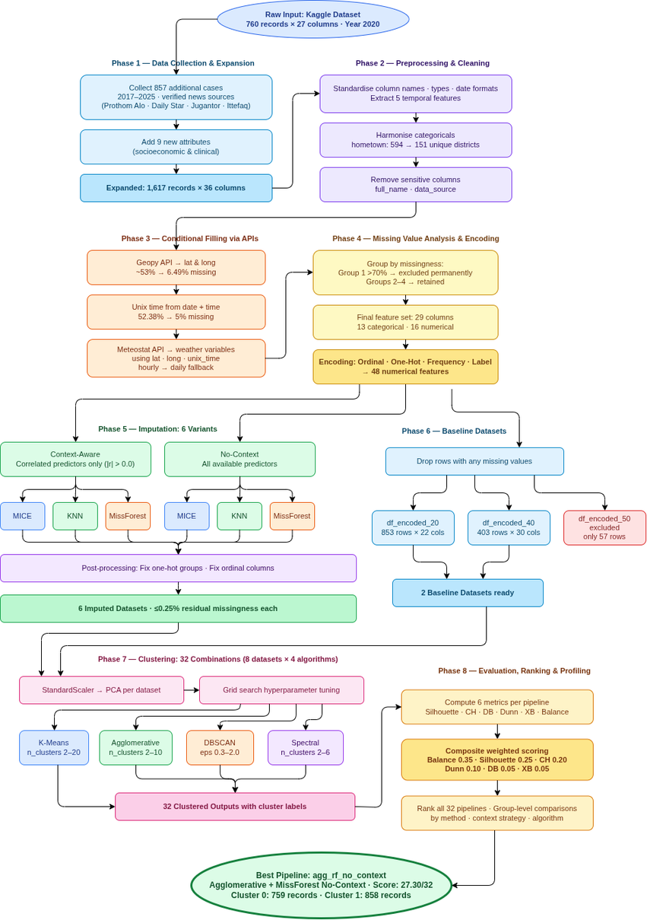
HERE IS
WHAT WE
BUILT
The full pipeline
33

Slide 34
SECTION 07
RESULTS
34

Slide 35
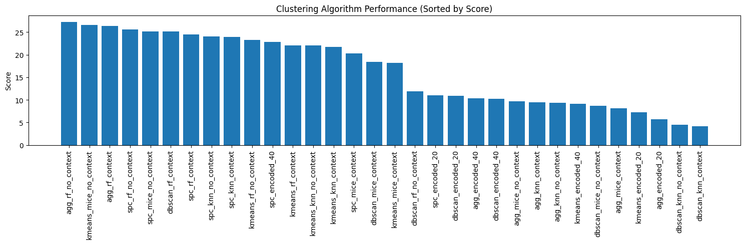
ALL 32 PIPELINES RANKED
The full ranking. Agglomerative + MissForest no-context leads the field at 27.30.
35

Slide 36
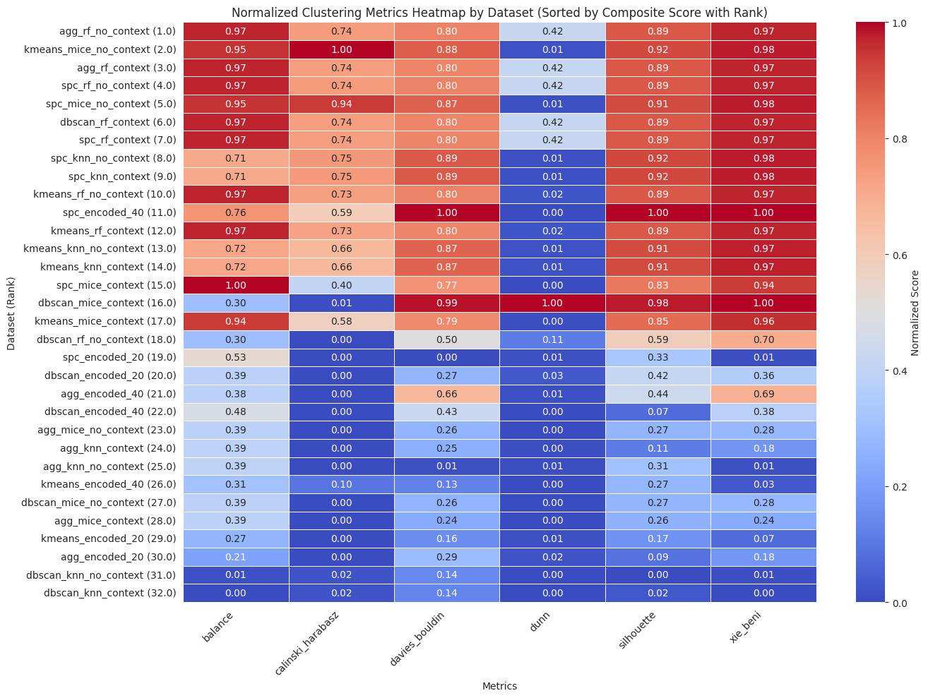
COMPOSITE SCORES · ALL 32 PIPELINES, ALL 6 METRICS
Per-pipeline, per-metric heatmap. Higher values are darker.
36

Slide 37
GROUP AVERAGES
Group | Average composite
MissForest variants | 23.27
MICE variants | 16.91
KNN variants | 14.92
Non-imputed baselines | 10.90
Algorithm | Average composite
Spectral | 22.18
K-Means | 18.80
Agglomerative | 13.28
37

Slide 38

THE TOP-RANKED PIPELINE
  Agglomerative + MissForest (no-context)
  Composite score: 27.30 / 32
  Cluster count: 2
38

Slide 39
TWO CLUSTERS
759
RECORDS
858 RECORDS
Cluster 0
Cluster 1
39

Slide 40
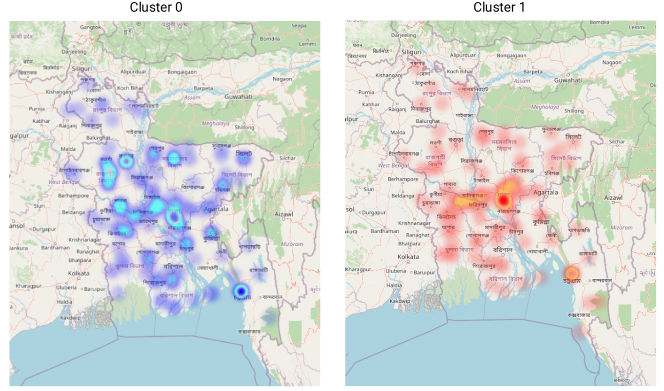
CLUSTERS GEOGRAPHIC DISTRIBUTION
40

Slide 41
CLUSTER PROFILING
Cluster 0 profile
Cluster 1 profile
  Workplace: semi-urban (54.5%) · rural (35.7%) · urban (9.7%)
  Workplace: rural (50.0%) · urban (26.6%) · semi-urban (23.4%)
  Top hometowns: Bogura (4.0%) · Rajshahi (3.6%) · Dhaka (3.4%) · Mymensingh (3.0%)
  Top hometowns: Dhaka (9.1%) · Chattogram (7.7%) · Barishal (2.6%) · Jessore (2.4%)
  Year coverage: 2020 only
  Year coverage: 2017–2019 + 2021–2025 (with small 2020 residue)
  Source cohort: Kaggle 2020
  Source cohort: manual collection
41

Slide 42
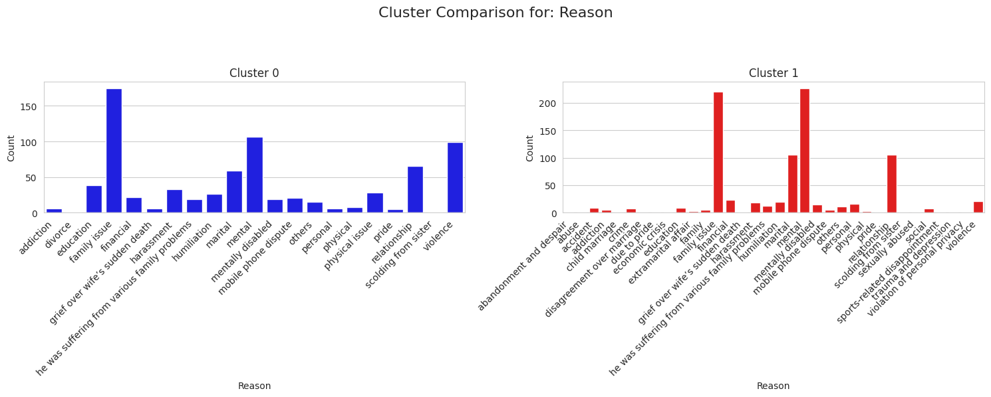
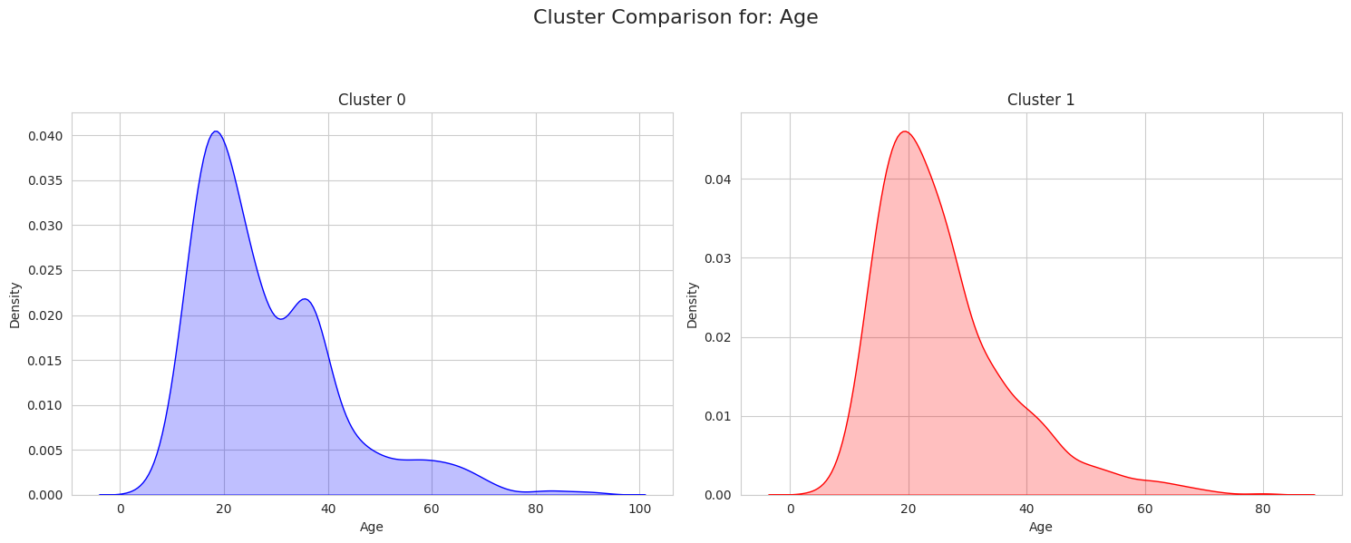
REASON COMPARISON:
AGE
COMPARISON:
42

Slide 43
SECTION 08
HONEST FINDINGS
43

Slide 44
AN HONEST FINDING
The two clusters align with the data-collection boundary, not with two distinct epidemiological groups.
44

Slide 45
HOW THE COHORTS MAP
  Cluster 0 = all 2020 (Kaggle subset)
  Cluster 1 = 2017–2019 + 2021–2025 (manually collected)
Note: the algorithm never saw the year — the split is emergent
Reading: an internal consistency check, not a substantive epidemiological finding
45

Slide 46
SECTION 09
ETHICAL CONCERN & TIMELINE
46

Slide 47
ETHICAL SAFEGUARDS
  full_name column removed at preprocessing
  Address coarsened to district level (no street/exact location)
  data_source URLs removed to prevent traceback to articles
  Suicide method retained only in encoded form, never reproduced at case level
  Source: publicly available Bangladeshi news outlets only
  Dataset released as de-identified, not formally anonymised
47

Slide 48
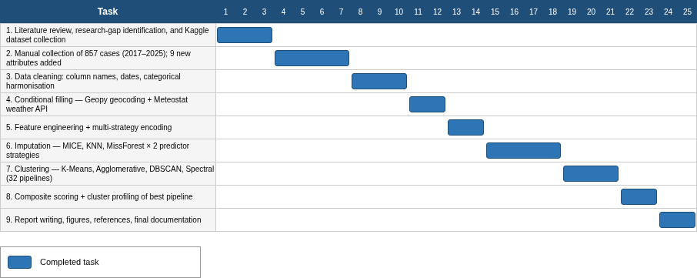
PROJECT TIMELINE · 25 WEEKS
48

Slide 49
SECTION 10
CLOSING
49

Slide 50
LIMITATIONS
  Newspaper bias toward newsworthy cases
  1,617 records — small by ML standards
  No external ground-truth labels
  Weather data sparse in rural areas
  Pipeline search space bounded by compute and time budget
50

Slide 51
FUTURE WORK
  SHAP / feature-importance analysis to surface cluster drivers
  Data expansion via more newspaper sources and other LMIC outlets
  Causal modelling — propensity-score matching, structural equation models
  BanglaBERT for free-text reason and profession fields
  Real-time alerting framework for high-risk demographic profiles
  Extension of the framework to other LMIC newspaper-derived datasets
51

Slide 52
CONTRIBUTION
  The largest curated Bangladeshi newspaper suicide dataset to date
  A reproducible 32-pipeline factorial benchmark
  A balance-aware composite metric that demotes degenerate clusters
  Open-source release: code + data + 12 Colab notebooks
52

Slide 53

REPOSITORY
  URL: github.com/akashmony01/imputation-clustering-comparison
  Code licence: MIT
  Data licence: CC-BY 4.0
  Contents: 12 Colab notebooks · intermediate datasets · cached external API responses
53

Slide 54

THANK
YOU

